Slide 1
Low Metallicity Dwarf Galaxies and the Future for the Primordial Helium Abundance
Evan Skillman
University of Minnesota
Diversity of the Local Universe
Special Astrophysical Observatory, October 1, 2019

Slide 2
Why Study Low Z Galaxies?
Records! It is fun to set a record.
Understanding of galactic chemical evolution in the extreme.
Chemical abundance ratios tell us about nucleosynthesis yields.
Can study star formation at low Z, which is a proxy for the early universe.
What sets the limit for the lowest Z?
The lowest metallicity galaxies can be used to measure the primordial helium abundance.

Slide 3
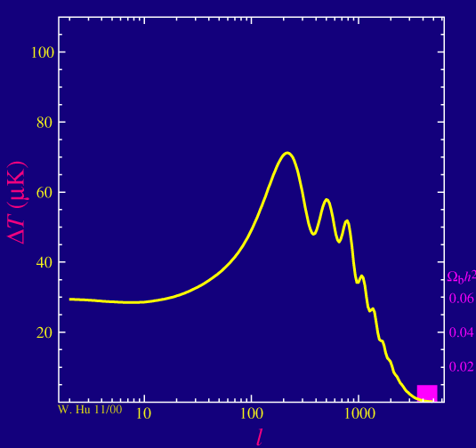
A Very Brief Introduction to SBBN
In the standard model, the Big Bang production of the light elements is dependent on a single parameter.
That parameter is the baryon-to-photon ratio (which is equivalent to the baryon mass fraction).
The cosmic microwave background radiation is very sensitive to the baryon-to-photon ratio, so it is measured very precisely.
Thus, using the CMB measurements
allow very precise predictions of the
primordial abundances of the light
elements.

Slide 4
CMB + BBN
CMB Power Spectrum highly sensitive to Ω_{B}
CMB+BBN
=> very high precision primordial abundance predictions
Ω_{B}h²= 0.02237±0.00015
η = (6.12±0.04) x 10⁻¹⁰
Y_{p} = 0.2447 ± 0.0002
Cyburt, Fields, Olive, Yeh (2015)

Slide 5
A Very Brief Introduction to SBBN II
In the standard model, there are three neutrinos.
What if we treat that as a free parameter?

Slide 6
CMB + BBN
CMB Power Spectrum highly sensitive to Ω_{B}
CMB+BBN
=> very high precision primordial abundance predictions
Ω_{B}h²= 0.02237±0.00015
η = (6.12±0.04) x 10⁻¹⁰
Y_{p} = 0.2447 ± 0.0002
N_{ν} = 2, 3, 4
Cyburt, Fields, Olive, Yeh (2015)

Slide 7
Why do you care about N_{eff}?
Riess + 2019

Slide 8
Constraints on N_{eff} from Y_{p}
In 2015, Aver et al. produced a new value for the primordial helium abundance (Y_{p}) – more on that later.
Taking the result from Aver et al. (2015) what does that imply for the number of neutrino species?

Slide 9
Y_{p}, D, BBN, the CMB, & N_{eff}
Cyburt, Fields, Olive, Yeh (2015)

Slide 10
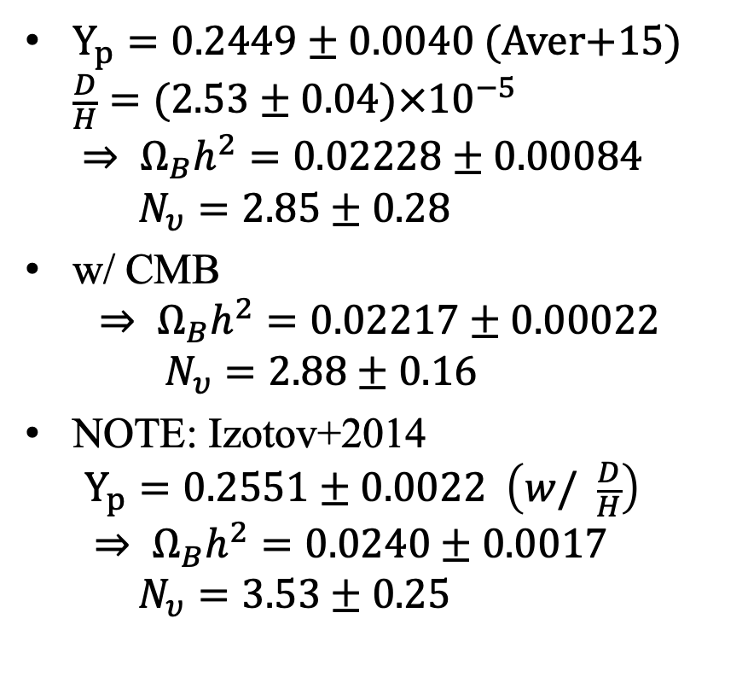
Y_{p} & BBN
$Y_{p}=0.2449±0.0040 (Aver$+15)
$\frac{D}{H}=(2.53±0.04)×{10}^{−5}$
$⇒ Ω_{B}h^{2}=0.02228±0.00084$
$N_{υ}=2.85±0.28$
w/ CMB
$⇒ Ω_{B}h^{2}=0.02217±0.00022$
$N_{υ}=2.88±0.16$
NOTE: Izotov+2014
$Y_{p}=0.2551±0.0022 \left(w/ \frac{D}{H}\right)$
$⇒ Ω_{B}h^{2}=0.0240±0.0017$
$N_{υ}=3.53±0.25$
Cyburt, Fields, Olive, Yeh (2015)

Slide 11
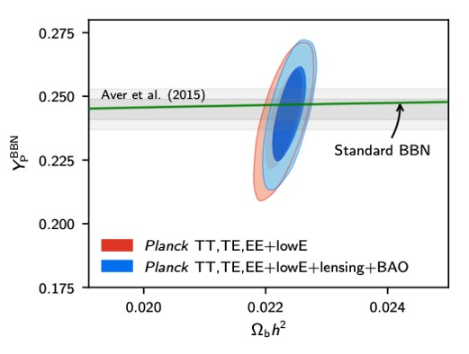
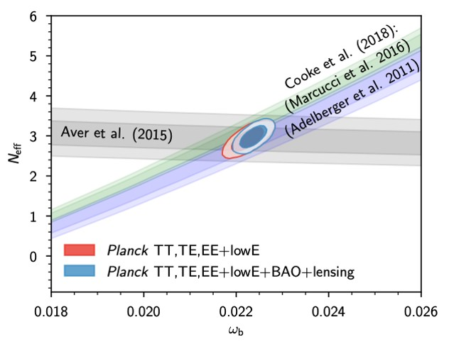
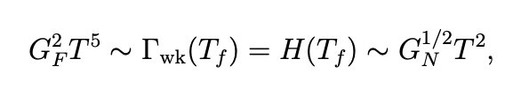
Y_{p}, BBN, & the CMB
Planck (2018)

Slide 12
How is Y_{p} determined?
By measuring He/H over a range in O/H, one can extrapolate back to O/H = 0, and that should be the primordial He abundance.
This is the connection to low metallicity galaxies – the galaxies with the lowest O/H where He/H can be measured accurately carry the most weight in this determination.

Slide 13
Aver, Olive, Skillman (2015)

Slide 14
Aver, Olive, Skillman (2015)
How can we improve on this?
Add New Low Z Targets
Reduce the Uncertainties on Individual Targets

Slide 15
(1) Add New Low Z Targets
The discovery of Leo P (Giovenelli et al. 2012) stimulated the search for new low z galaxies.
Leo P was discovered in a blind HI search (the Arecibo ALFALFA program).
It had an HII region making a chemical abundance analysis possible.
It is a very low Z galaxy.

Slide 16
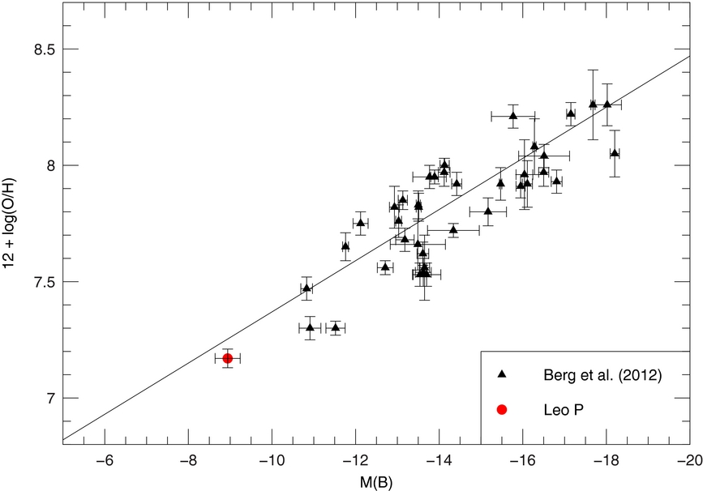
(1) Add New Low z Targets
Skillman+ (2013)

Slide 17
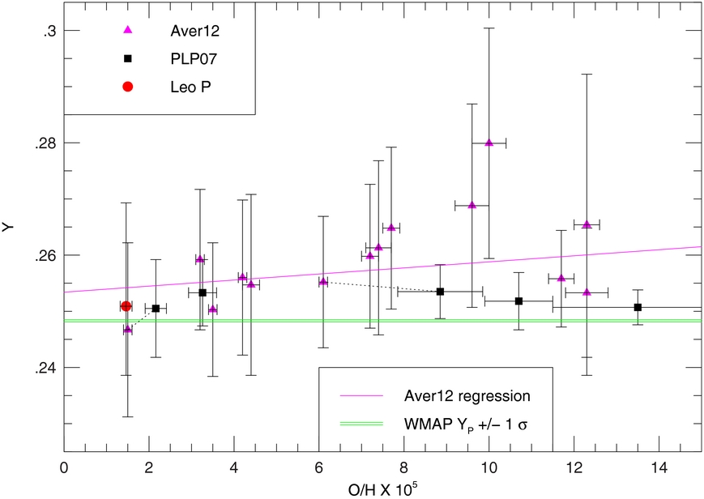
(1) Add New Low z Targets
Skillman+ (2013)

Slide 18
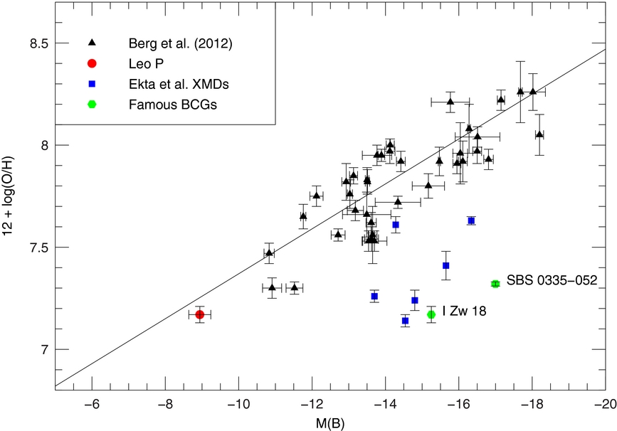
(1) Add New Low Z Targets
Skillman+ (2013)
Where Ekta et al = Ekta, Chengalur, & Pustilnik!

Slide 19
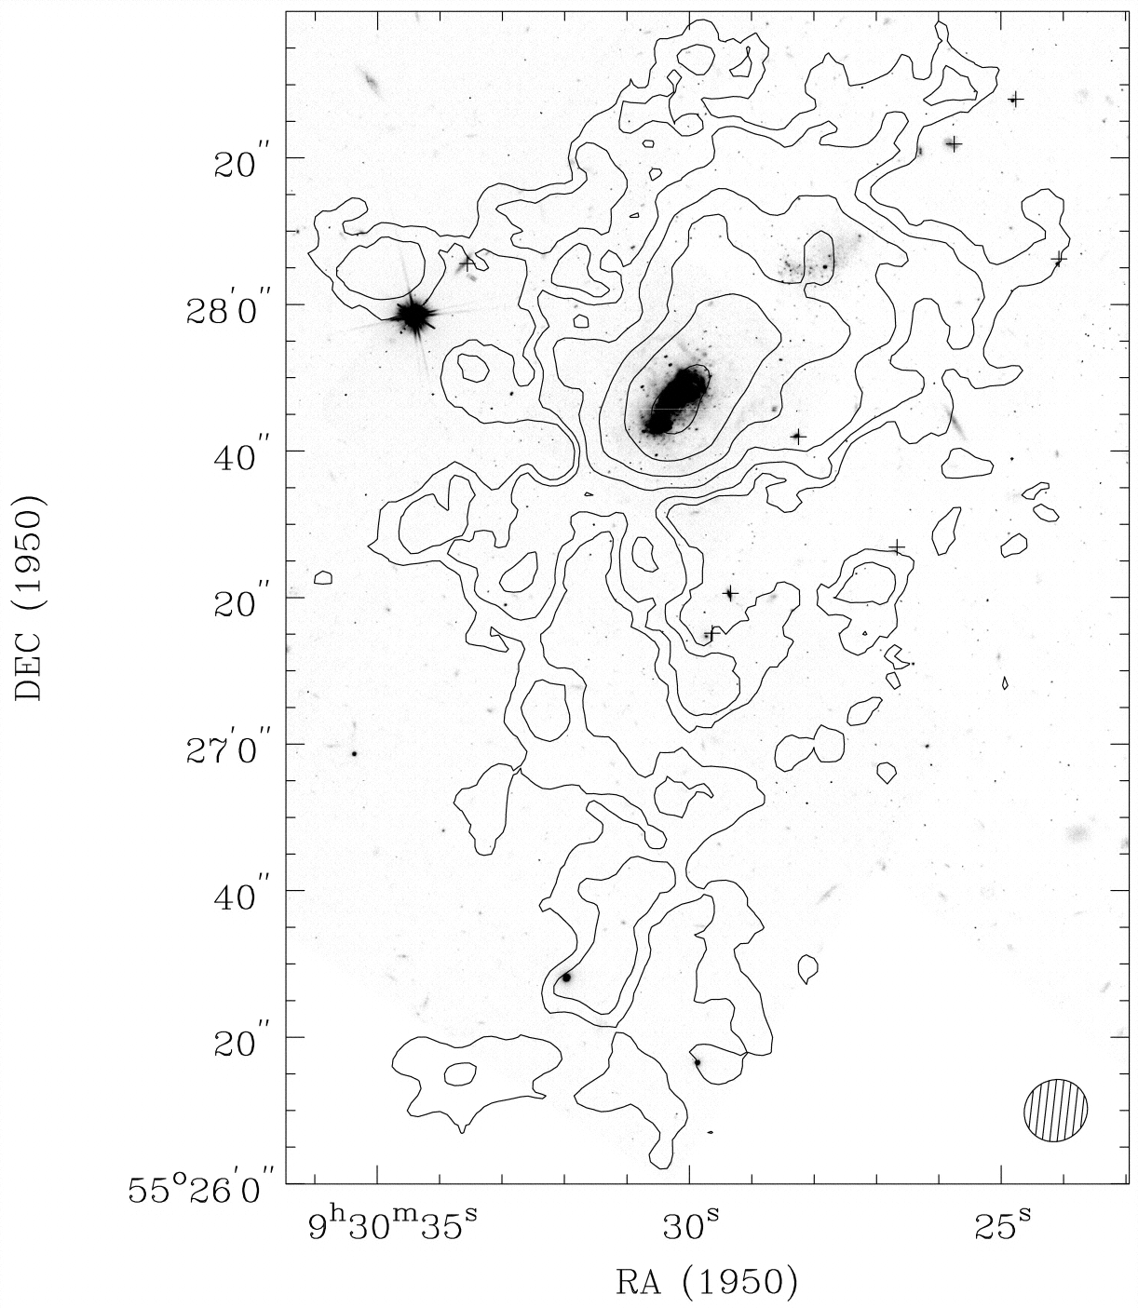
An Aside (HI in IZw18)
Van Zee+ (1998)

Slide 20
(1) Add New Low Z Targets
The discovery of Leo P was followed by the discovery of AGC 198691 (“Leoncino”) at an even lower value of O/H (Hirschauer+16).
Leoncino was also discovered in the Arecibo ALFALFA program.
Recently, McQuinn+19 have published an HST TRGB distance so that we have intrinsic properties for Leoncino.

Slide 21
(1) Add New Low Z Targets
McQuinn+ (2019)

Slide 22
(1) Add New Low Z Targets
McQuinn+ (2019)

Slide 23
(1) Add New Low Z Targets
In the last few years there have been a number of programs leading to the discovery of extremely low metallicity galaxies (<~5% of solar O/H):
Yang+17: 3 galaxies (blueberries)
Guseva+17: 3 galaxies
Hsyu+17: 1 galaxy (little cub)
Izotov+18,19: 2 galaxies
Senchyna+19: 2 galaxies

Slide 24
(1) Add New Low Z Targets
“Blueberry” Galaxies Yang+ (2017)

Slide 25
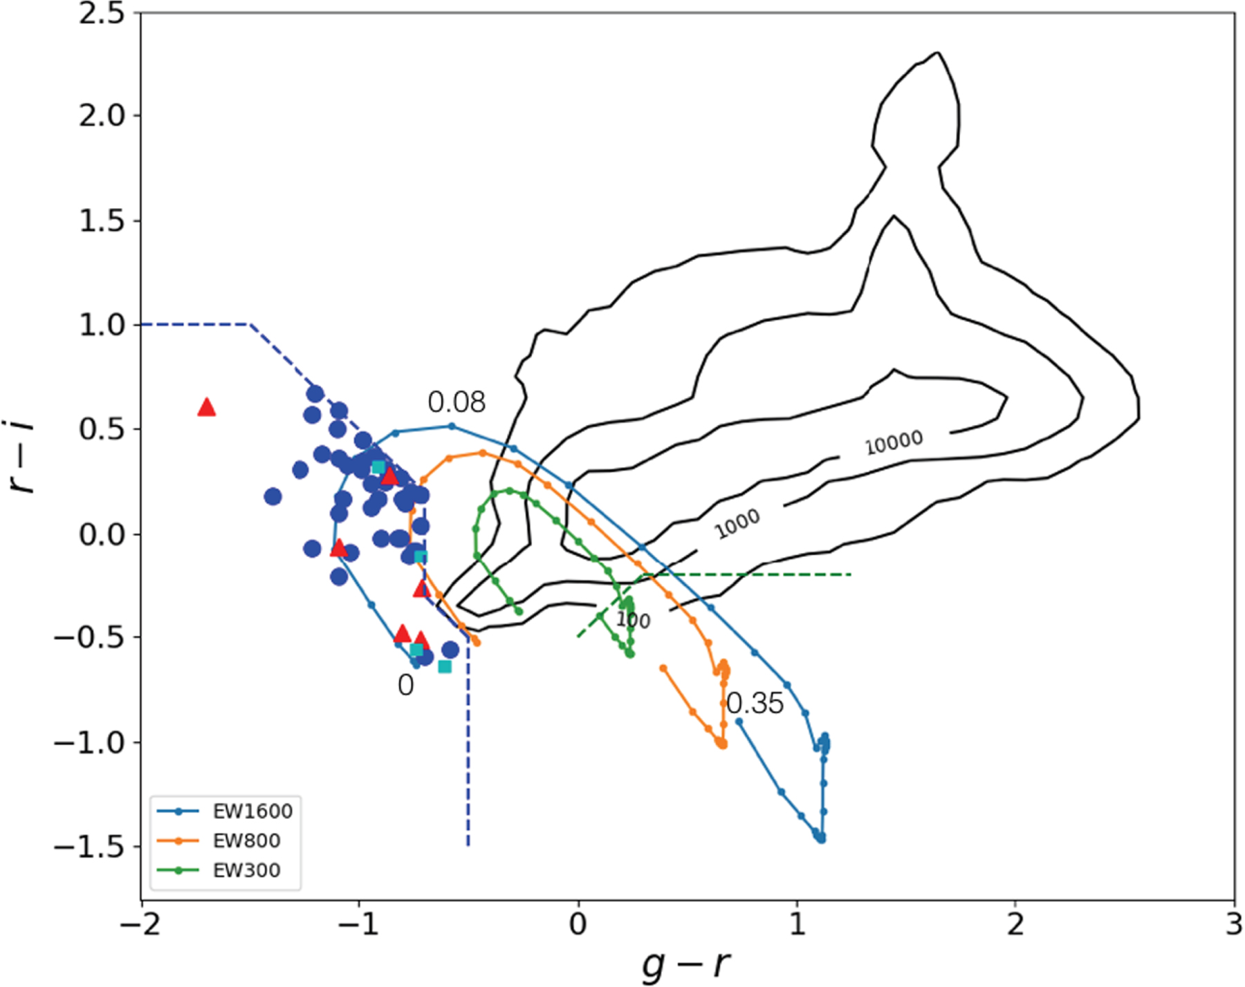
(1) Add New Low Z Targets
Yang+ (2017)

Slide 26
(1) Add New Low Z Targets
Hsyu+ (2018)

Slide 27
(1) Add New Low Z Targets
McQuinn+ (2019)

Slide 28
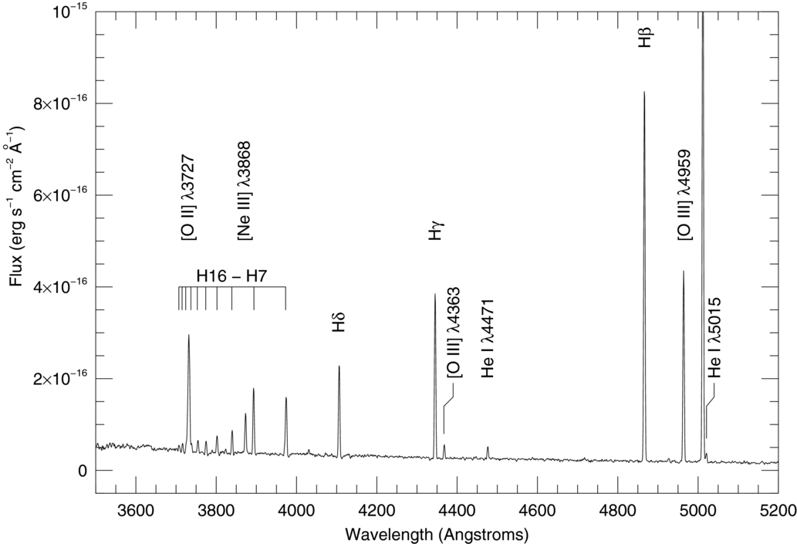
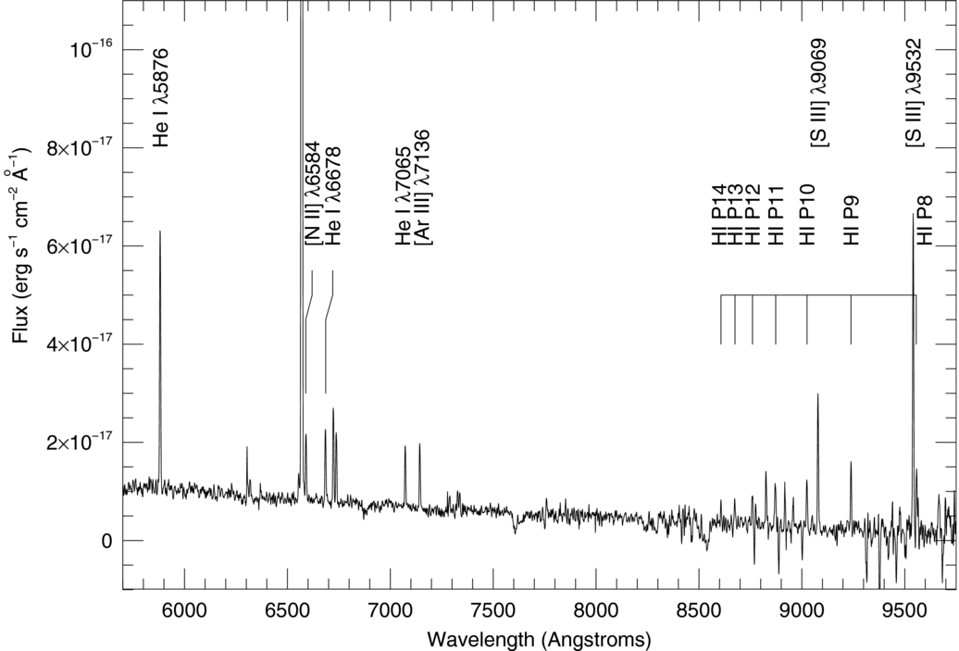
(2) Reduce the Uncertainties
Leo P LBT spectrum Skillman+ (2013)

Slide 29
It’s Simple, Right?
Measure an Emission Line Spectrum
Measure the Electron Temperature and Density
Calculate the Emissivity
Convert relative Fluxes into Abundances
Plot He/H vs. O/H, and Regress back to O/H=0

Slide 30
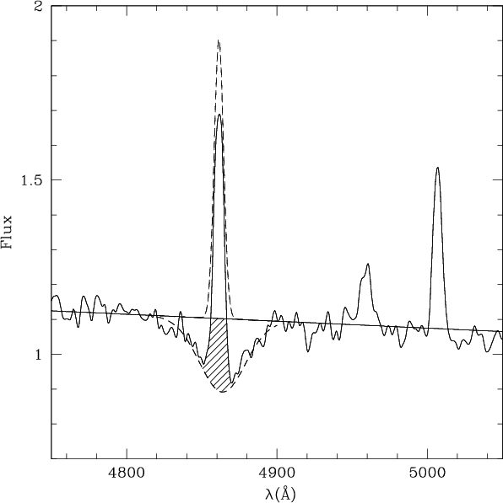
Complications
Emission Lines:
- Reddening
- Underlying Absorption
Temperature & Density
- Which Ion?
- Fluctuations
Collisional Excitation
Self-Absorption of He I
(Optical Depth)

Slide 31
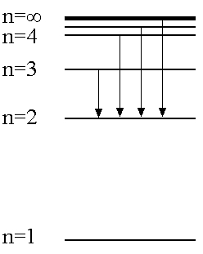
Determine ⁴He & Corrections Simultaneously
He λ3889, 4026, 4471, 5876
6678, 7065, 10830 (IR)
Hα, Hβ, Hγ, Hδ
  Model for observed fluxes
  y⁺, n_{e}, a_{He}, τ, T, C_{Hβ}, a_{H}, ξ
  Minimize

Slide 32
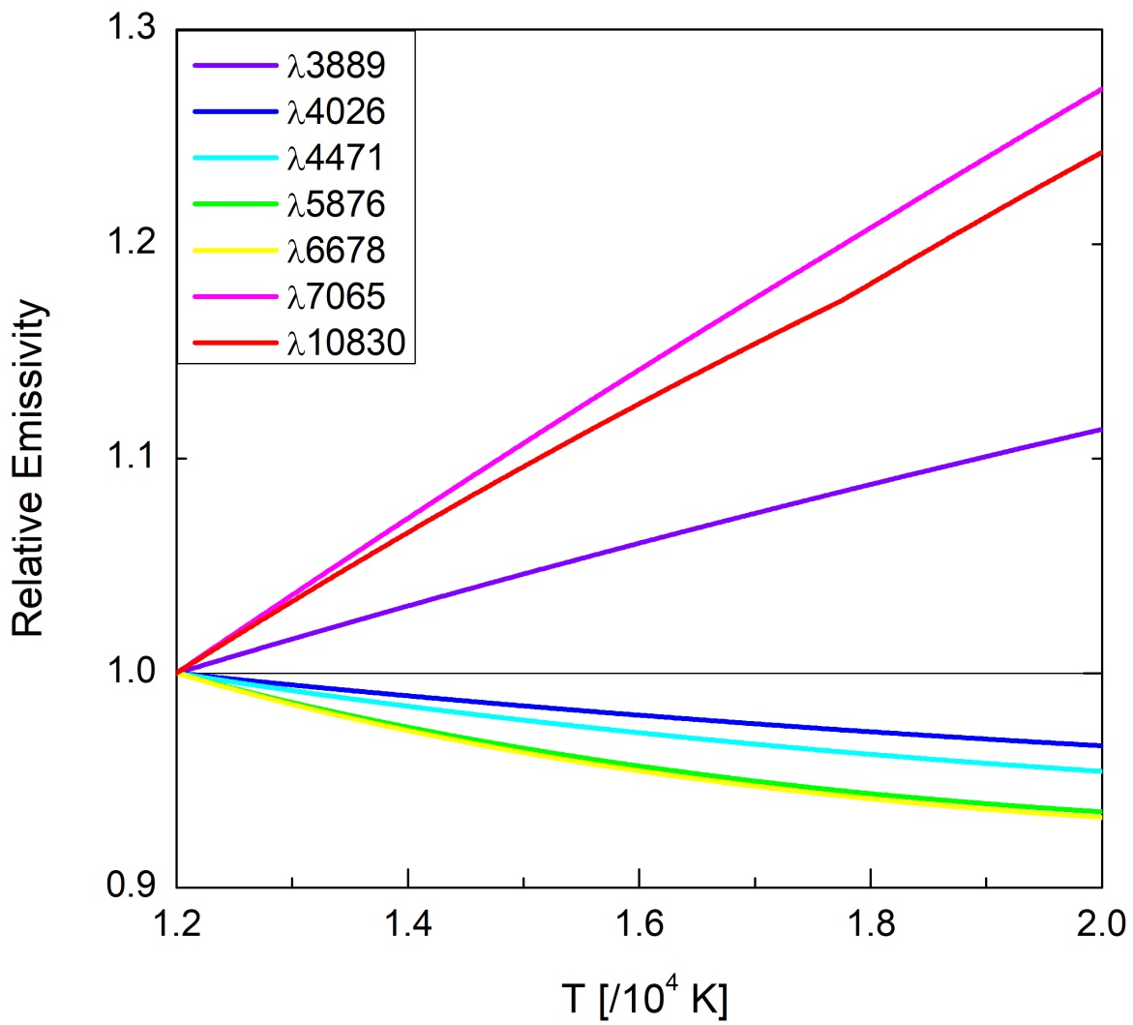
Parameter Dependence
Aver, Olive, Skillman (2015)

Slide 33
State of ⁴He
Most Recent Result: Y_{p} = 0.2449 ± 0.0040
Planck BBN Result: Y_{p} = 0.2470 ± 0.0002
- Agree well
- Realistic Uncertainty
- Goal is to Reduce Uncertainty
Higher Quality & Higher Resolution Spectra
- LBT
- IR
- Additional H Lines

Slide 34
Recent Improvements
Higher Quality & Higher Resolution Spectra
- LBT MODS Spectra
- LBT near-IR Spectra
- Include additional H I lines in solution
- Include additional He I lines in solution
- Improved atomic data for H collisional excitation
- Improved modeling of underlying H and He absorption
=>As a result, roughly factor of two reduction in He/H uncertainty on individual objects!

Slide 35
Summary
BBN’s ability to predict the light element abundances with high precision is a great accomplishment of the Big Bang model.
Our current determination of the Primordial Helium Abundance agrees well with the CMB result.
Self-consistent analysis of ⁴He using MCMC has proved insightful and effective.
More targets and higher quality spectra are needed (and coming!).
Constraints on N_{eff} will be tightened.

