Slide 1


Circlet of star-forming clumps in NGC 4324
Proshina I.S.
in collaboration with
Kniazev A.Yu., Moiseev A.V., Sil'chenko O.K.
SAI MSU of M.V. Lomonosov
Diversity of Local Universe 2019
SAO, Nizhnij Arkhyz
01 October, 2019

Slide 2
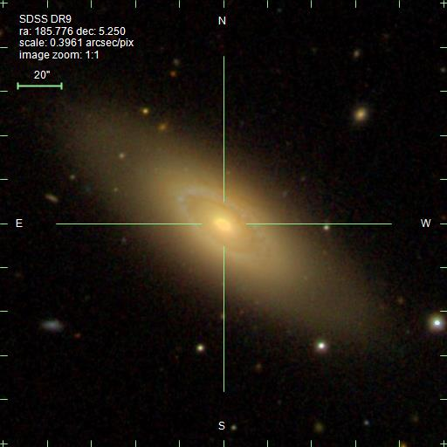
NGC 4324
M_{B}, mag (HyperLeda) | -19.75
M_{H}, mag (NED) | -23.64
v _{sys}, km/s (NED) | 1665
Distance, Mpc (NED) | 21.7
z (NED) | 0.0056
Scale, kpc/arcsec | 0.105
M(HI), 10⁸M⊙ (EDD) | 17
M(H2), 10⁸M⊙ | 0.9
Environment (HyperLeda, NED) | Galaxy from group NGC4303 (23 objects)

Slide 3
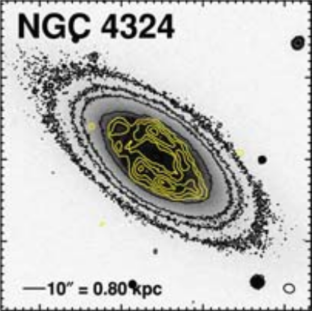
Molecular gas distribution in NGC 4324
r-band images (grey-scale and black contours) overlaid with integrated CO(1–0) contours (yellow) at 10, 30, 50, 70 and 90 per cent of the peak intensity
Credit from: Alatalo, K., Davis, T. A., Bureau, M., et al. 2013, MNRAS, 432, 1796.

Slide 4
Observational data
The long-slit spectral observations were made with the spectrograph RSS installed at the 11m telescope SALT in the South African Astronomical Observatory at 10 March 2013.
Summary exposition – 40 min.
The spectral range 3750 – 6850 Ǻ, spectral resolution 5,5 Ǻ,
The slit width was 1,25 arcsecond.
The slit was aligned with the major axis of the galaxy; PA = 233˚.
Detailed study is based on the data obtained with an imaging instrument MaNGal – a narrowband tunable filter – developped in the SAO RAS.
Also we have used optical, UV and IR images from SDSS, GALEX and WISE archives respectively.

Slide 5
Kinematics of stars and gas in the NGC 4324
The line-of-sight velocities of the ionized gas in the galaxy were determined by means of Gaussian multi-component fitting of the [NII]λ6548+6583+Hα(emission)+Hα(absorption) line blend and the [OIII]λ5006.9 and [SII]λ6716.4, 6730.6 emission lines .
The line-of-sight velocities of stars in the galaxy were determined by means of cross-correlating blue-green part (4050-5590 ǺǺ) of the spectra with the spectrum of a K-giant star.

Slide 6
Kinematics of stars and gas in the NGC 4324

Slide 7
Results of the isophote analysis
1. Position angle of the galaxy NGC 4324 along the radius
r, arcsec

Slide 8
Results of the isophote analysis
2. The isophote ellipticity of the galaxy NGC4324 along the radius
r, arcsec

Slide 9
3. Profile of surface brightness of the galaxy NGC 4324
Results of the isophote analysis

Slide 10
Stellar population properties
Measurement of the Lick indices (Hβ, Mgb, Fe5270, Fe5335) along the radius (major axis).
Estimation of the SSP-equivalent ages, metallicities and magnesium-to-iron abundance ratios by means of diagnostic diagram (Thomas D., Maraston C., Bender R., 2003).

Slide 11
Stellar population properties
The estimate of SSP-equivalent ages and metallicities of the stellar population in the galaxy NGC 4324 in the center (r<3''; 3"<r≤6‘’), in the inner disk (7''≤r≤16") and in the ring-like region (17''≤r≤ 35")
The estimate of magnesium-to-iron abundance ratios [Mg/Fe] in the galaxy NGC 4324 along the radius

Slide 12
Gaseous component in the galaxy NGC 4324
EW of the emission lines variation in the galaxy NGC 4324
Log ₁₀[NII]6583/H_{α} along the radius of the galaxy NGC 4324

Slide 13
Gaseous component in the galaxy NGC 4324
Log10 [SII]Σ/Hα along the radius of the galaxy NGC 4324

Slide 14
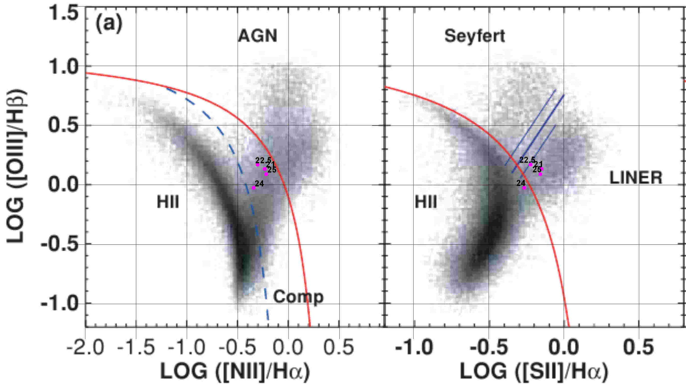
Gaseous component in the galaxy NGC 4324
For ring-like region in the gaseous disk we have used BPT-diagnostic diagrams (Kewley L.J. et al., 2006) to separate gas excitation mechanisms

Slide 15
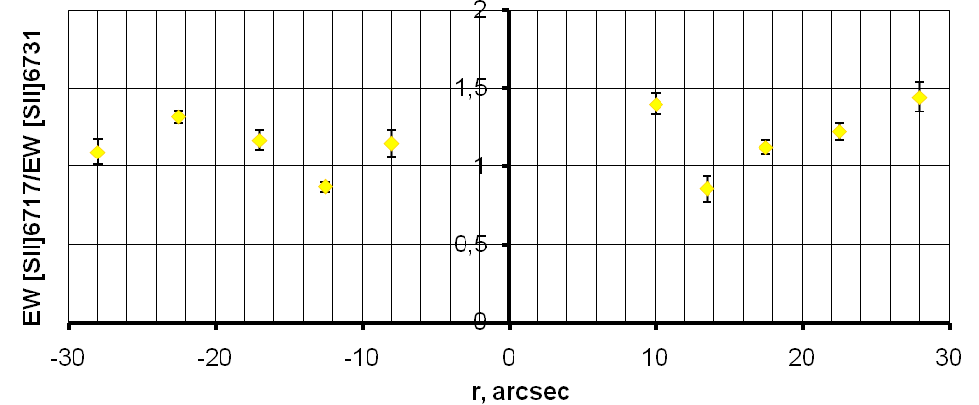
Gaseous component in the galaxy NGC 4324
Estimation electron density in the ionized gas by using relation EW[SII]_{6716.4}/EW[SII]_{6730.6} and nomograme by Osterbrock & Ferland (2006)
Ratio EW[SII]6716.4/EW[SII]6730.6 along the radius of the galaxy NGC 4324
Electron density along the radius of the galaxy NGC 4324

Slide 16
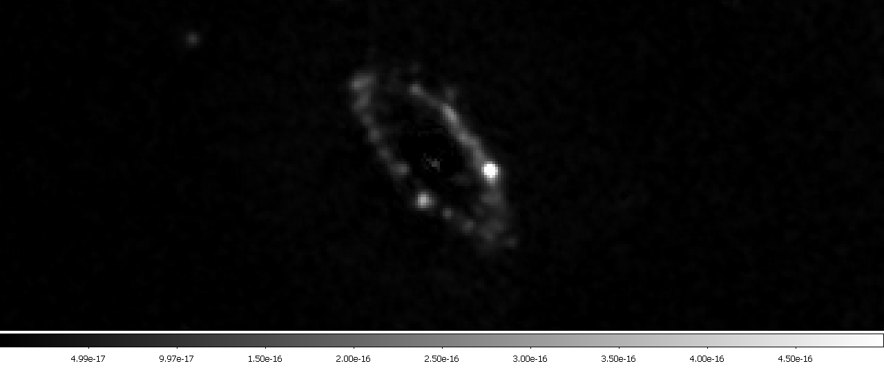
Hα-image of the ring in NGC 4324

Slide 17
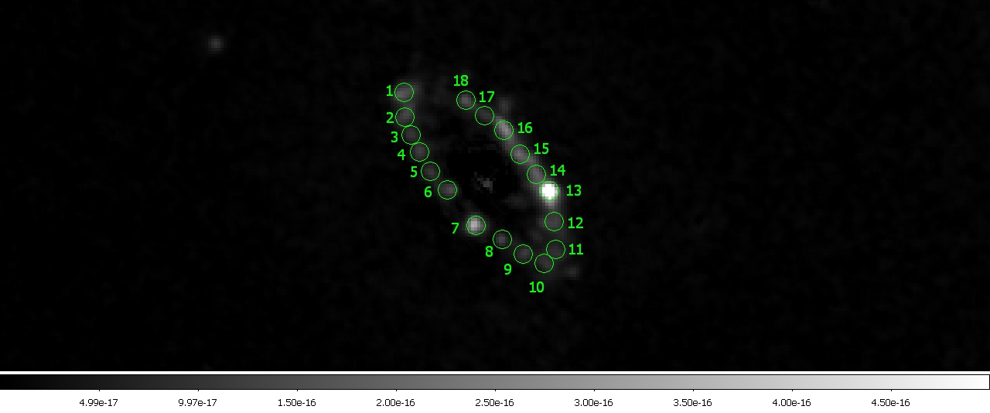
Hα-image of the ring in NGC 4324
rclump =2 " ⬄ 0.2 kpc

Slide 18
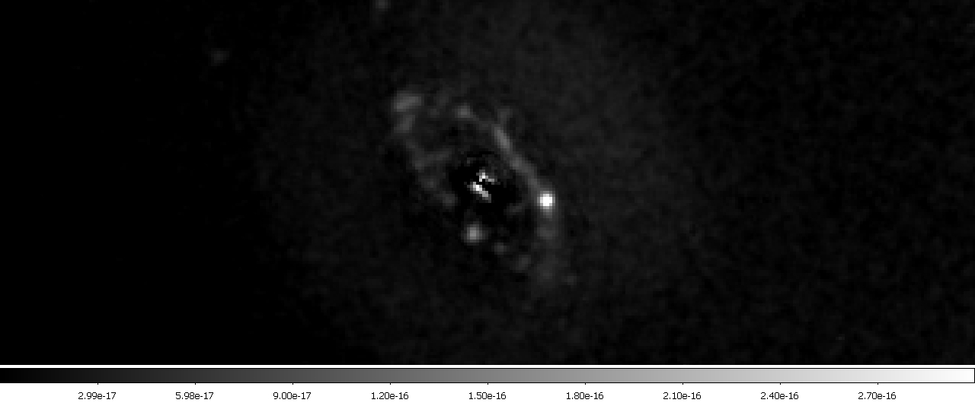
[NII]-image of the ring in NGC 4324

Slide 19
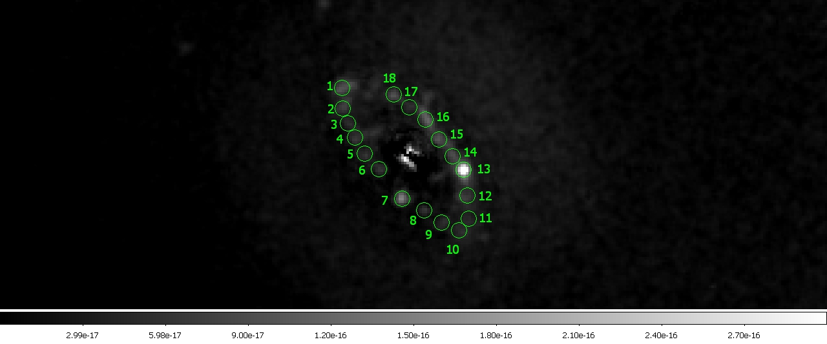
[NII]-image of the ring in NGC 4324
rclump =2 " ⬄ 0.2 kpc

Slide 20
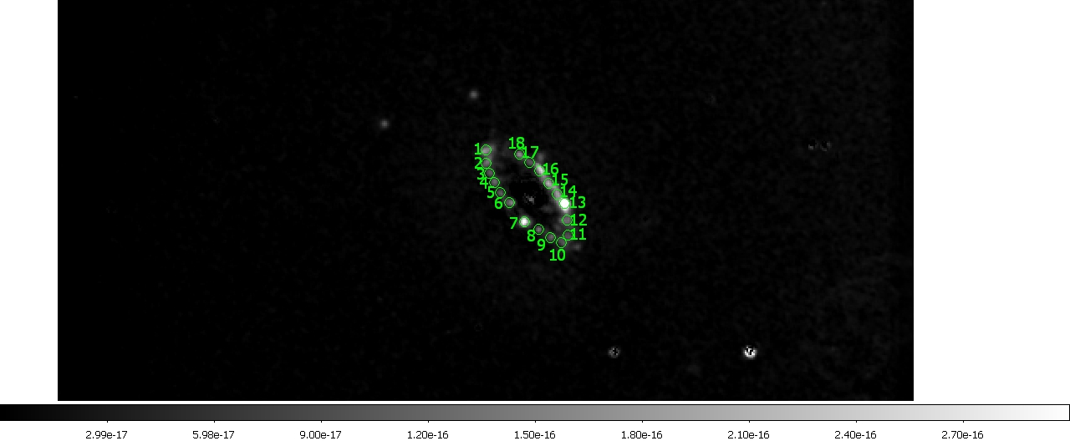
Hα-image around of the ring in NGC 4324

Slide 21
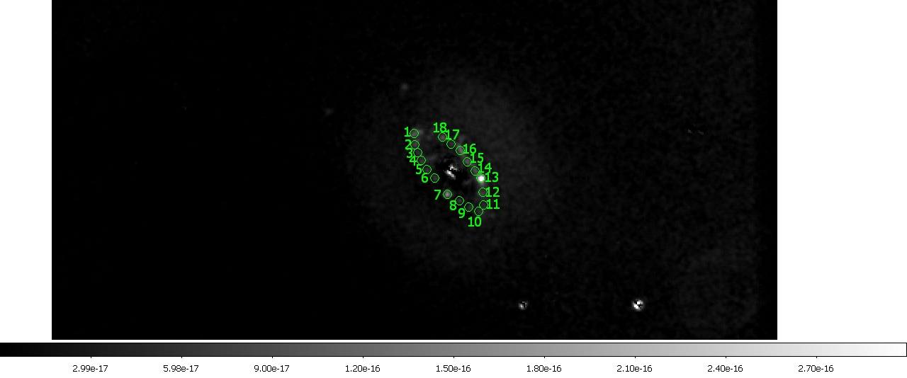
[NII]-image around of the ring in NGC 4324

Slide 22
Distance variations between centers of the clumps

Slide 23
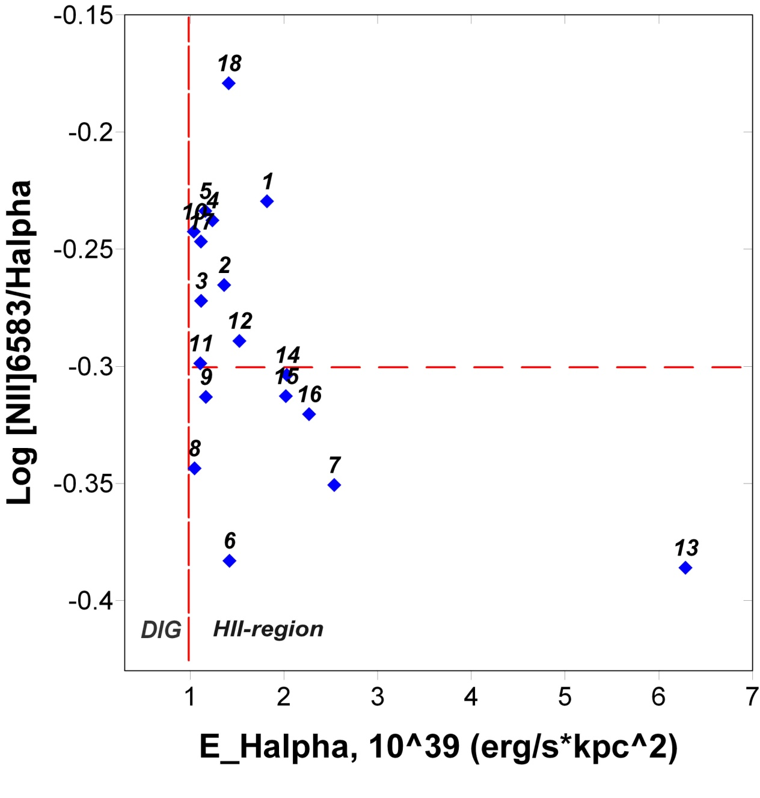
Distinguish between HII and DIG regions/clumps
Threshold log ΣHα of 39 adopted by Zhang K., et al., 2017, MNRAS, 466, 3217

Slide 24
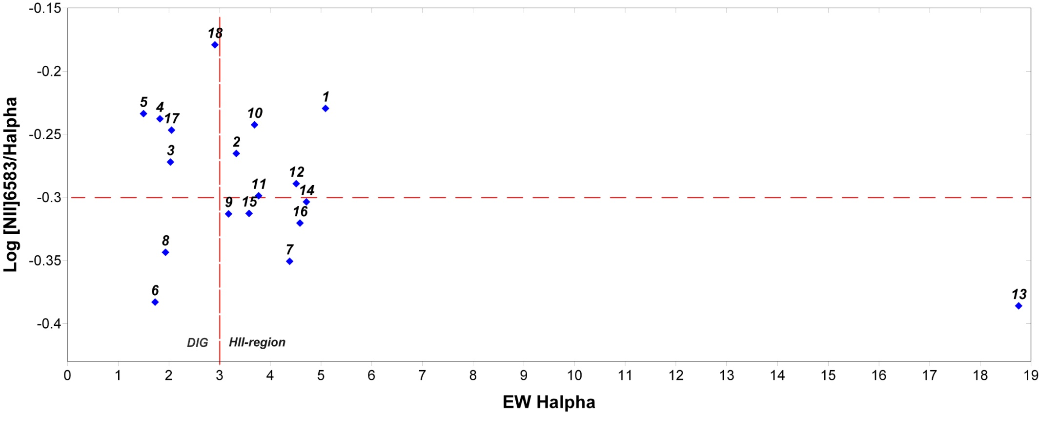
Distinguish between HII and DIG regions/clumps

Slide 25
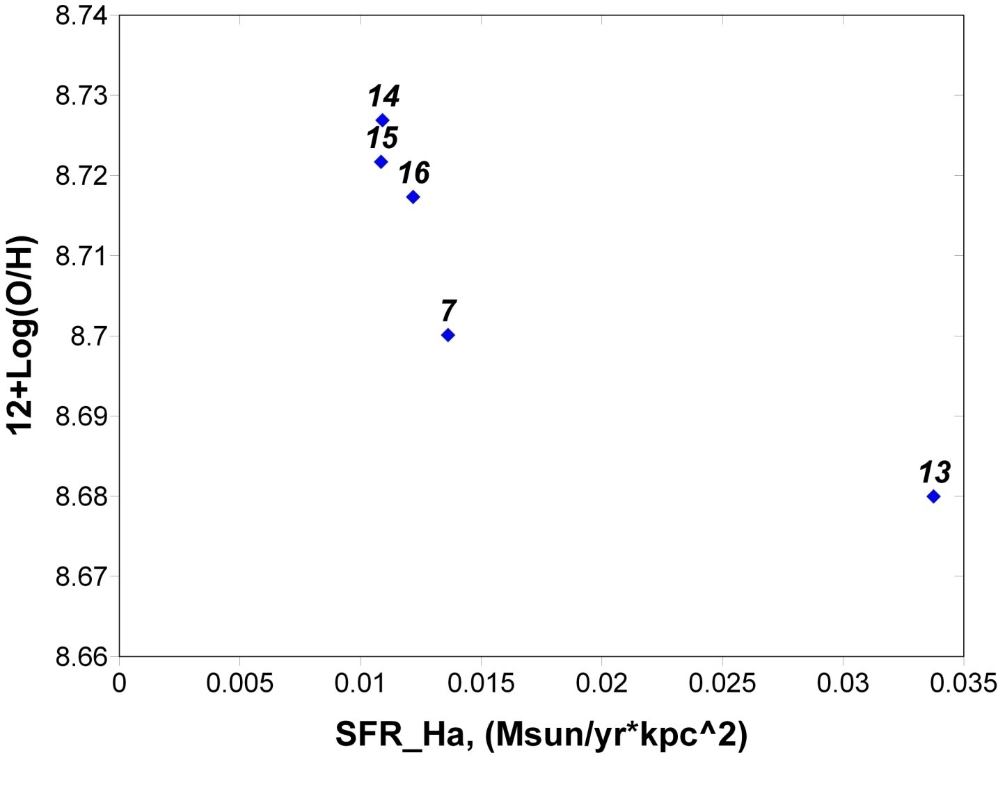
Variation of gas metallicity along the ring in NGC 4324
Estimation gas metallicity by using formula (Pettini & Pagel, 2004) only for regions with gas excitation dominated by the star-forming :
12+log(O/H)=8,90+0,57*(log{[NII]λ6583/Hα})

Slide 26
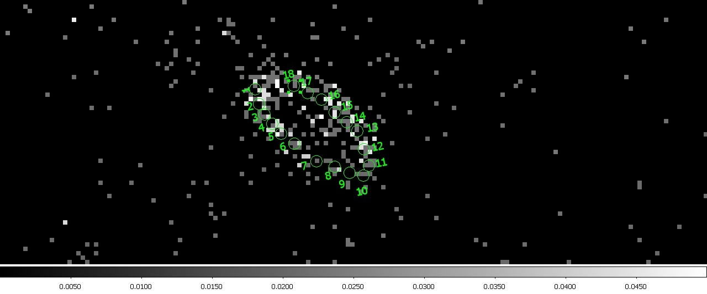
FUV-image of the ring in NGC 4324

Slide 27
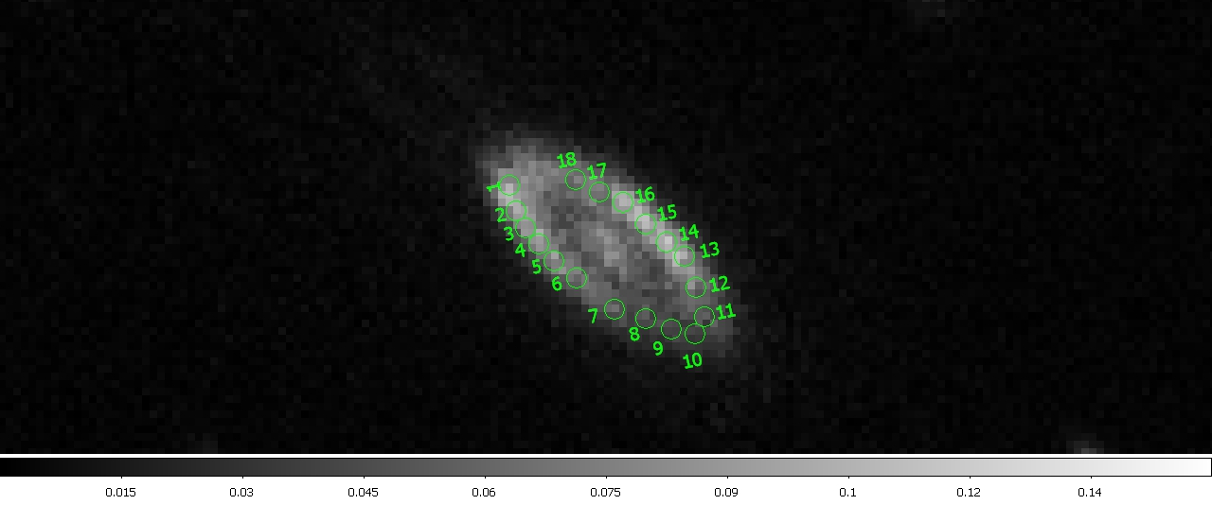
NUV-image of the ring in NGC 4324

Slide 28
SFR density variations along the ring
Note: determination of star formation rates by using the formulas from R.C. Kennicutt, N. J. Evans. Annu. Rev. Astron. Astrophys. 2012. 50:531–608

Slide 29
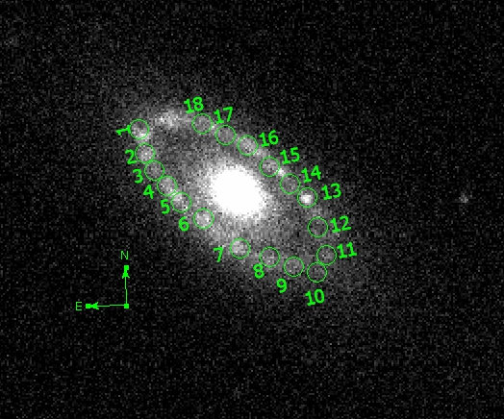
u (SDSS) image of the ring in NGC 4324

Slide 30
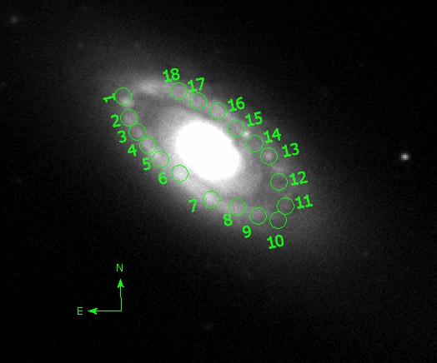
g (SDSS) image of the ring in NGC 4324

Slide 31
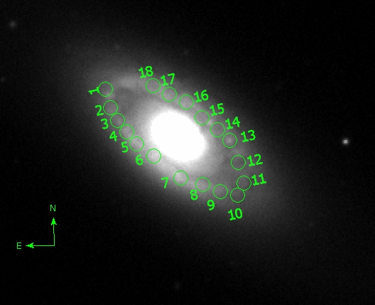
r (SDSS) image of the ring in NGC 4324

Slide 32
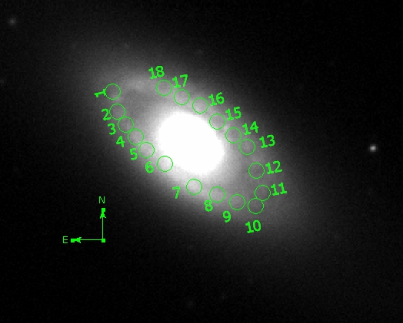
i (SDSS) image of the ring in NGC 4324

Slide 33
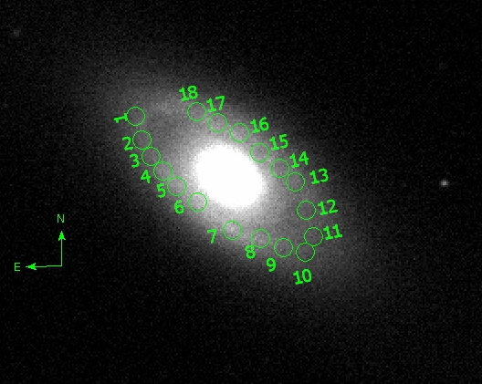
z (SDSS) image of the ring in NGC 4324

Slide 34
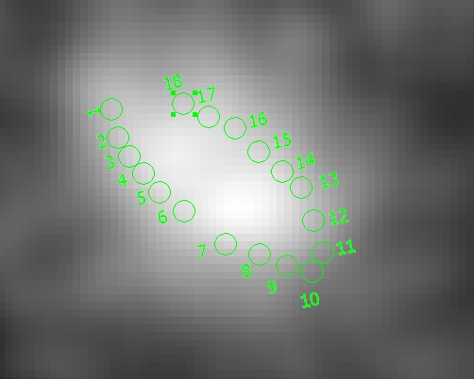
WISE_W4 (22 μm)-image of NGC 4324

Slide 35
Summary
In the lenticular galaxy NGC 4324 molecular, atomic and ionized gas is detected.
The gaseous disk and ring in the NGC 4324 is coplanar with respect to the stellar disk.
The ionized gas is excited by star-forming process observed in a ring-like region at distance 2.5 kpc from the center and width about 0.5 kpc along the radius.
Star formation is very inhomogeneous along the ring. Star-forming regions are assembled into the clumps with possible radius about 0.2 kpc and characteristic distance between centers of the clumps about 0.4 – 0.5 kpc.
At the same distance from center the stellar and gaseous metallicities are different: the gas reveals near-solar oxygen abundance while the stellar population at the same radius is metal-poor.
Starformation in clumps proceeds in form of brief bursts, presumably, repeating during a few hundred Myr.
Possible sources of the gas accretion may be minor merging with gas-rich satellites.

Slide 36
Thank you for attention!

